Slide 1

Quantitative Finance Model Visualizer Using High Frequency Trading Algorithms
cv
Phase – II Review 2
Under the Guidance of
Prof. Sunanda,
Dept of Computer Science and Engineering
Team Members :
1. Xitiz Verma(1DS19CS193)
2. Soumya Kumari(1DS19CS161)
3. Yashaswini Shree (1DS19CS196)
4. Mohammed Shagil Khan (1DS20CS415)
Department of Computer Science & Engineering, DSCE

Slide 2

Introduction
Stock price prediction is one of the most challenging problems as a high level of accuracy is the key factor in predicting a stock market. Many methods are used to predict the price in the stock market but none of those methods are proven as a consistently acceptable prediction tool due to its volatile nature.
•
.

Slide 3
Contribution of Each Team Member :
Xitiz Verma(1DS19CS193)
Collecting and Preprocessing Stock Data Set
Cleaning and Organizing Data Set into required Format
Training and Testing K-Nearest Neighbour Algorithm
Calculating RMSE, RME, RMA Error Rates for KNN & GRU Model
Implementing Variance Regression Score
Implementing Gamma Deviance and Mean Poisson Deviance
Plotting the next 1 month of predicted Stock Data Graphically
Comparing and Analyzing the Expected Stock Values with the Actual Values
9. Documenting Implementation Paper and Literary Survey Paper

Slide 4
Soumya Kumari(1DS19CS161)
1. Researching about Time-Statistical indicators:
2. Skewness, Kurtosis, HV
3. Training and Testing Support Vector Regression Algorithm
4. Calculating RMSE, RME, RMA Error Rates for SVR Model
5. Implementing Variance Regression Score
6. Implementing Gamma Deviance and Mean Poisson Deviance
for SVR Model.
7. Plotting the next 1 month of predicted Stock Data Graphically
8. Comparing and Analyzing the Expected Stock Values with the
Actual Values
9. Documenting Literary Survey Paper and Publishing

Slide 5
Mohammed Shagil Khan (1DS20CS415)
1. Researching about Time-Statistical indicators:
2. Documenting Literary Survey
3. Training and Testing Random Forest Algorithm
4. Calculating RMSE, RME, RMA Error Rates for RF Model
5. Implementing Variance Regression Score
6. Implementing Gamma Deviance and Mean Poisson Deviance
for RF Model.
7. Plotting the next 1 month of predicted Stock Data Graphically
8. Comparing and Analyzing the Expected Stock Values with the
Actual Values
9. Documenting Literary Survey Paper and Publishing

Slide 6
Co-guide interaction and issues and solutions/changes
Meeting | Suggestions | Implementation / Solutions
Meeting 1 | Suggestion about models and how to proceed further. | Implemented LSTM model for prediction
Meeting 2 | Compare different models and analyze the accuracy of outputs | Implemented and compared LSTM , SVR, LSTM with GRU , KNN models
Meeting 3 | Suggestions about Frontend | Used python library and implemented frontend.

Slide 7
Yashaswini Shree (1DS19CS196)
1. Researching about Time-Statistical indicators:
2. Skewness, Kurtosis, HV
3. Training and Testing Long Short Term Memory Algorithm
4. Calculating RMSE, RME, RMA Error Rates for LSTM Model
5. Implementing Variance Regression Score
6. Implementing Gamma Deviance and Mean Poisson Deviance
for LSTM Model.
7. Plotting the next 1 month of predicted Stock Data Graphically
8. Comparing and Analyzing the Expected Stock Values with the
Actual Values
9. Documenting Implementation Paper and Literary Survey Paper

Slide 8
Methodology
Institutional traders and investment companies possess the human and financial capital necessary to employ Quant models in their trading strategies. Additionally, with large amounts of money on the line, institutional investors are often required to backtest to assess risk
Prerequisites for Quantitative Finance
Before you start analyzing a trading strategy, you need to consider some of the factors:
Trading logic
Market segment
Data
Programming language
Let us look at each of these factors in detail.

Slide 9
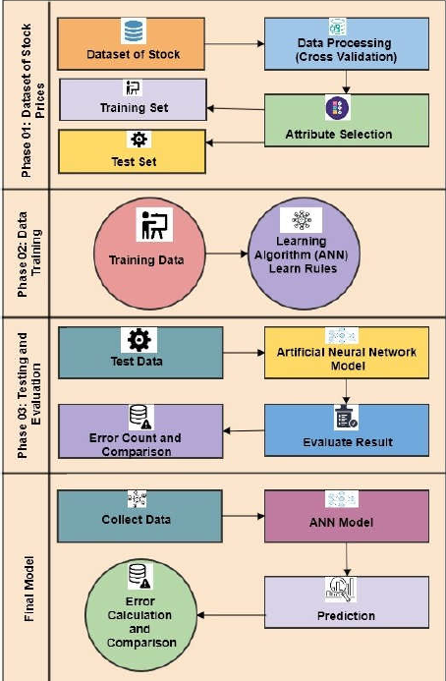
System Architecture

Slide 10
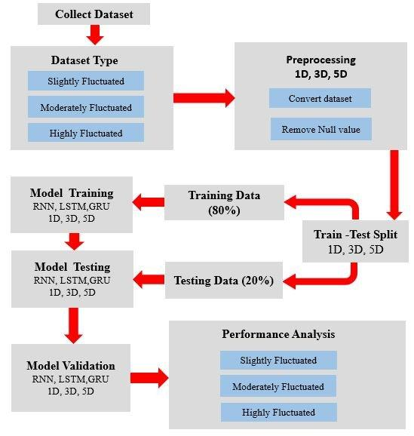

Slide 11
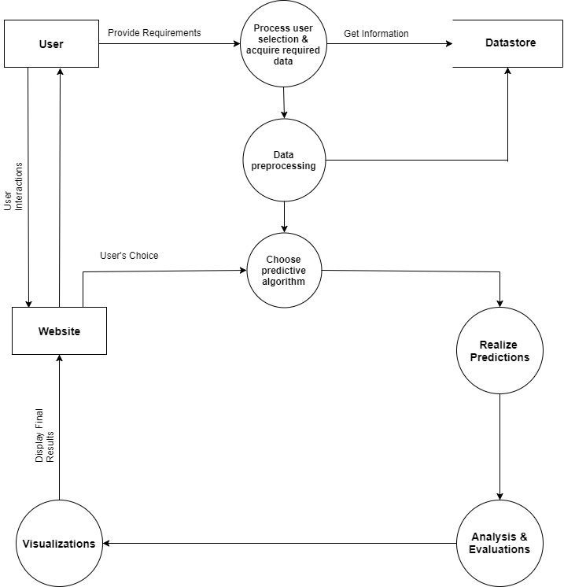
Data Flow Diagram

Slide 12
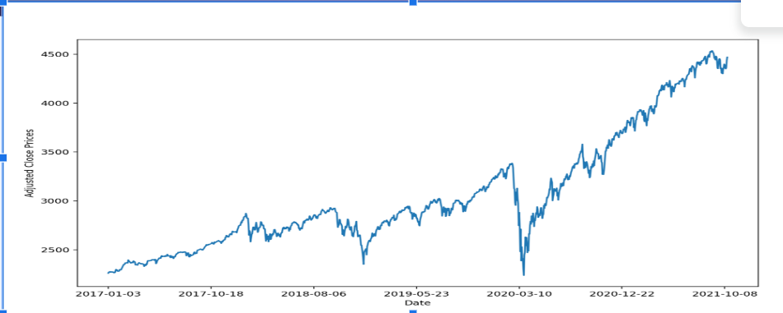
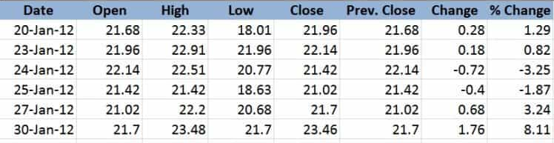
Time series analysis

Slide 13

Support Vector Regression

Slide 14
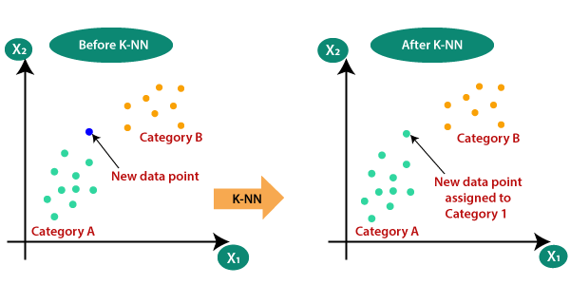
K-Nearest Neighbour Algorithm

Slide 15
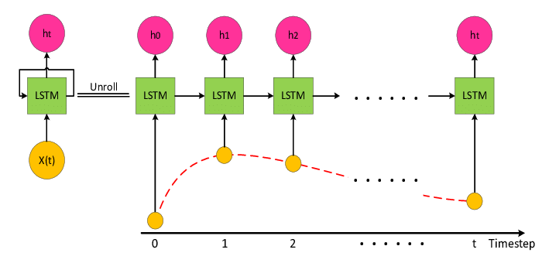
Long-term short memory

Slide 16
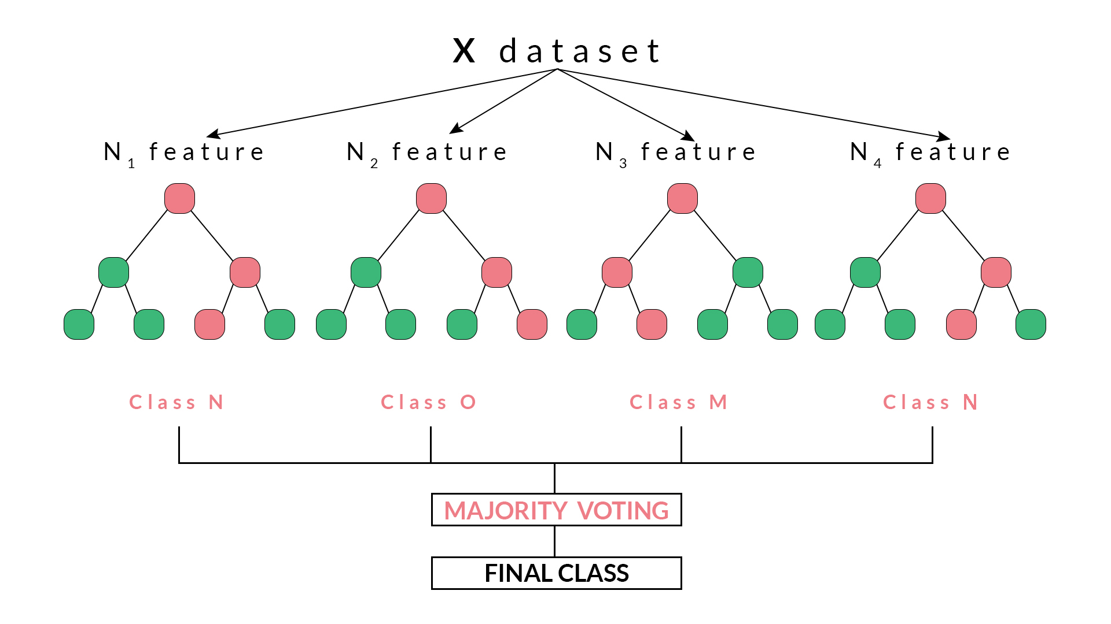
LSTM With Random Forest

Slide 17
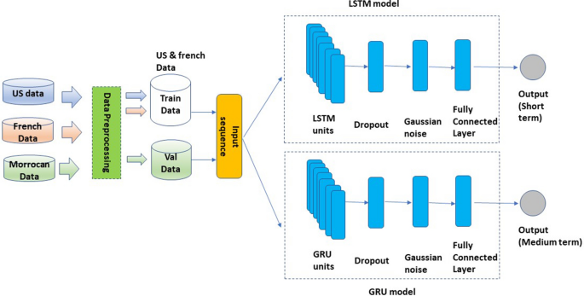
LSTM With GRU (HYBRID Model)

Slide 18
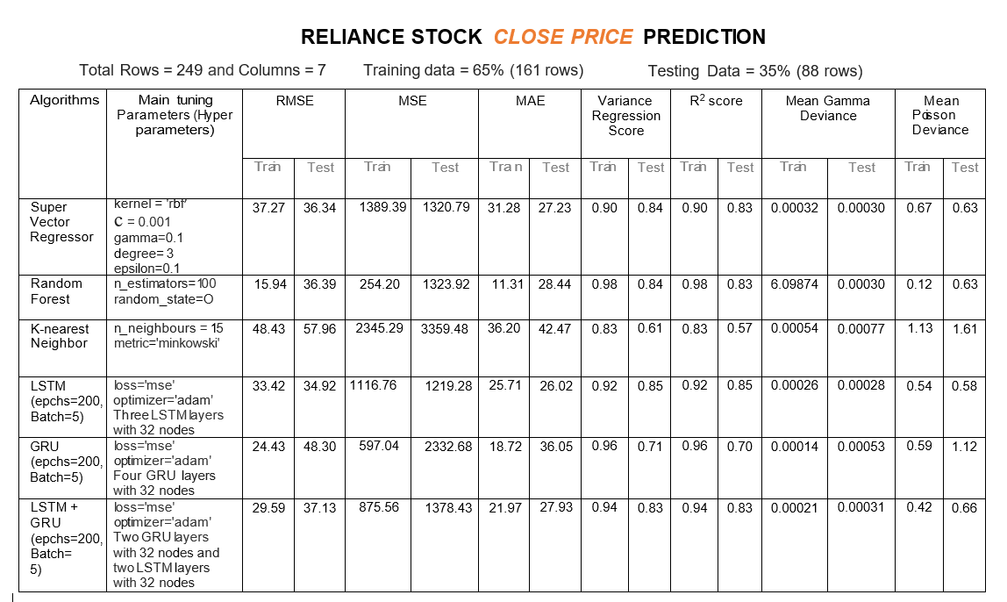

Slide 19
Conclusion
This study used the Indian Stock Market financing dataset and a variety of methodologies. We are predicting the closing stock price of any given organization, we have developed an application for predicting close stock prices using the LSTM algorithm. We have used datasets belonging to Nifty50 Stocks and achieved above-high accuracy for these datasets.
Positive outcomes have been achieved thanks to these strategies, which have improved prediction accuracy.
The study and forecast of stocks using recently released machine learning techniques have produced encouraging results, paving the way for their implementation in lucrative exchange schemes. It has led to the conclusion that by employing machine learning techniques, stock market predictions can be made more effectively and accurately.

Slide 20
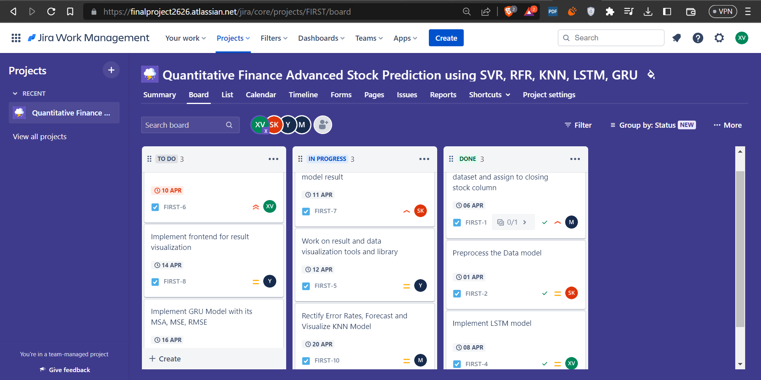
Project Management Tool Snapshot

Slide 21
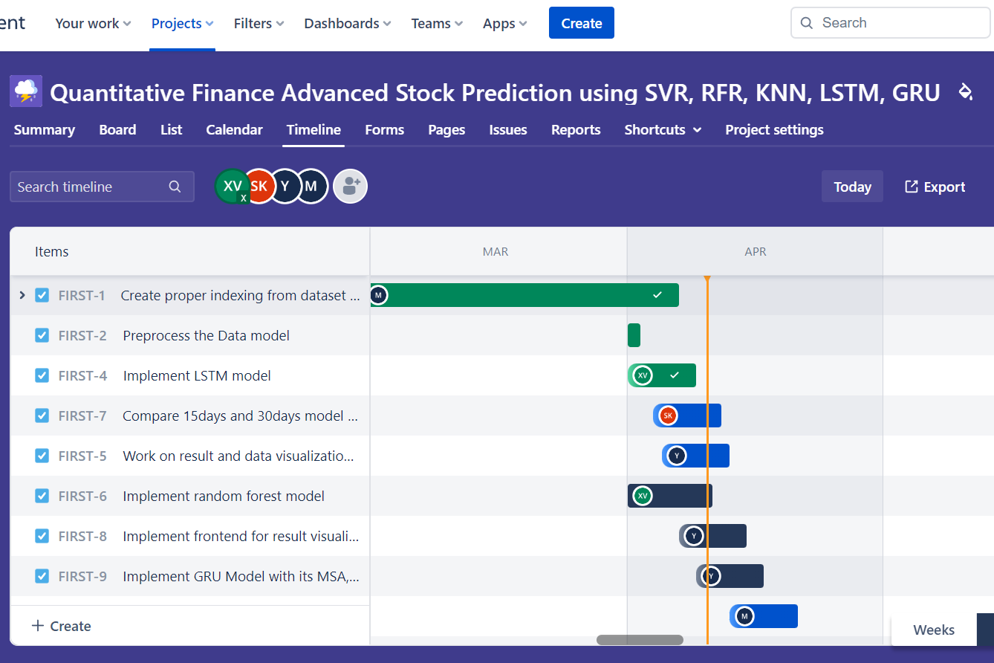
Timelines :

